Slide 1
Finding Your Next Game
A Games Recommendation Capstone Project
by Mahamed Abdulle

Slide 2
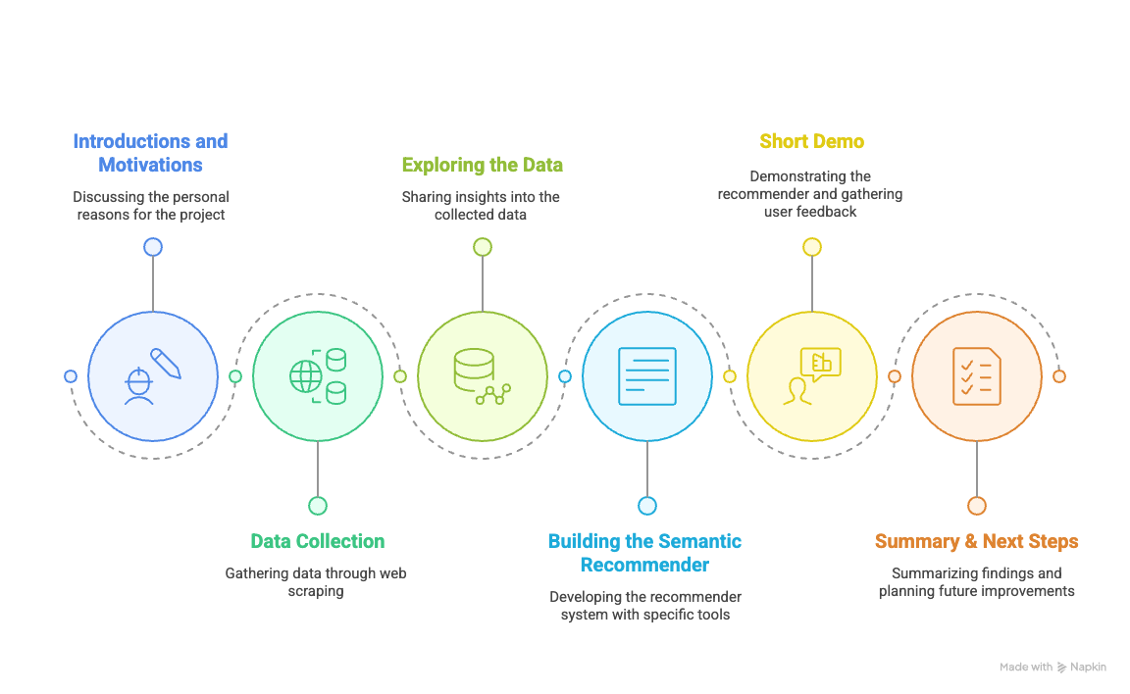
Table of Contents
generated by napkin ai

Slide 3
Introductions & Motivations

Slide 4

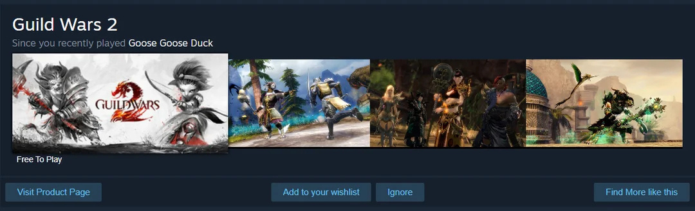
Introductions & Motivations
About Me:
Passionate about gaming, with a strong interest in the souls-like genre
Experienced Steam user, with a solid understanding of the platform from a user’s perspective
I built this to improve recommendations—Steam’s aren’t great.
It relies on user tags, not story or content.
So similar tags often mean bad matches—like the example shown.

Slide 5
Data Collection

Slide 6
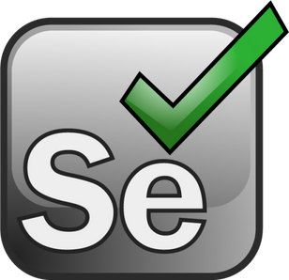

Data Collection
Initially planned to download data from Kaggle
Data wasn’t up-to-date
Switched to web scraping instead
Faced infinite scroll issue on Steam
Used Selenium to auto-scroll and collect data

Slide 7
Exploring the Data

Slide 8
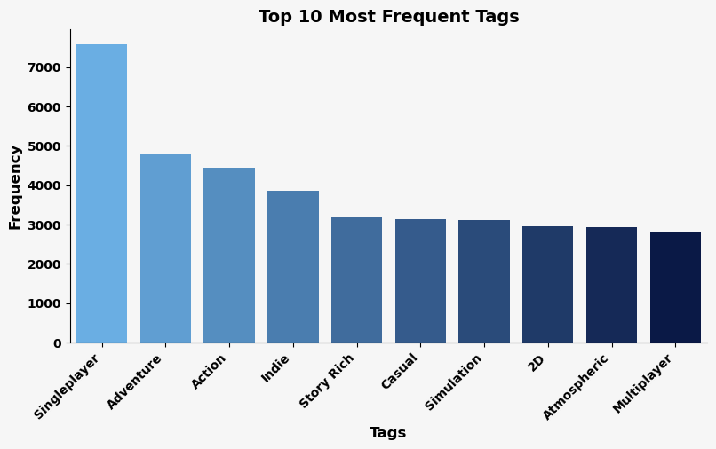
What are the 10 most common tags?
Steam has 446 unique tags
Most Frequent Tag is Singleplayer

Slide 9
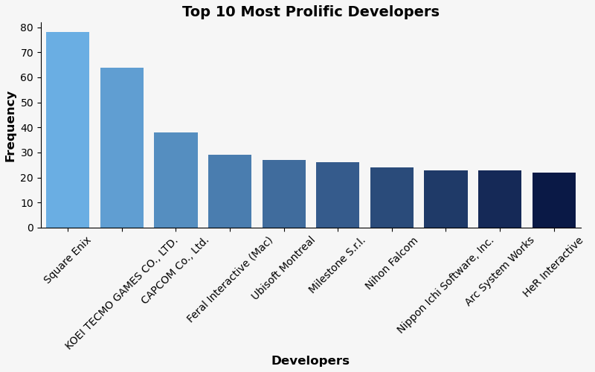
Who are the developers who make the most games?
There are 6952 developers on Steam who have published games.
Square Enix produce the most amount of games released on Steam.

Slide 10
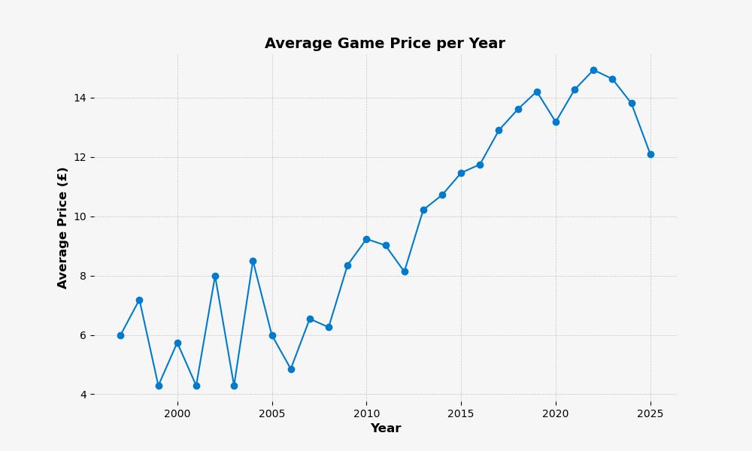
Average costs of a game per year?
At first glance, games look like they are becoming more expensive
Steam works differently, older games are no longer sold at release price but discounted.
The average price for 2025 looks low, but due to limited data

Slide 11
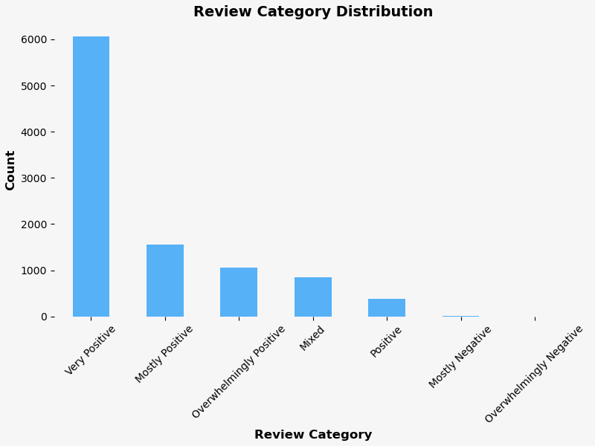
Review Category Distribution
The majority of games receive positive reviews, with "Very Positive" and "Mostly Positive" making up the largest portions.
Negative reviews are rare, suggesting most games are generally well-received.

Slide 12
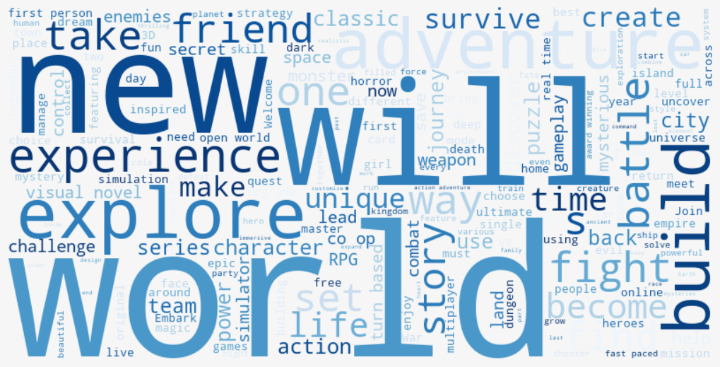
Word Cloud
The most common word in game descriptions is "world".
This reflects the popularity of open-world games, now a major selling point in the industry.

Slide 13
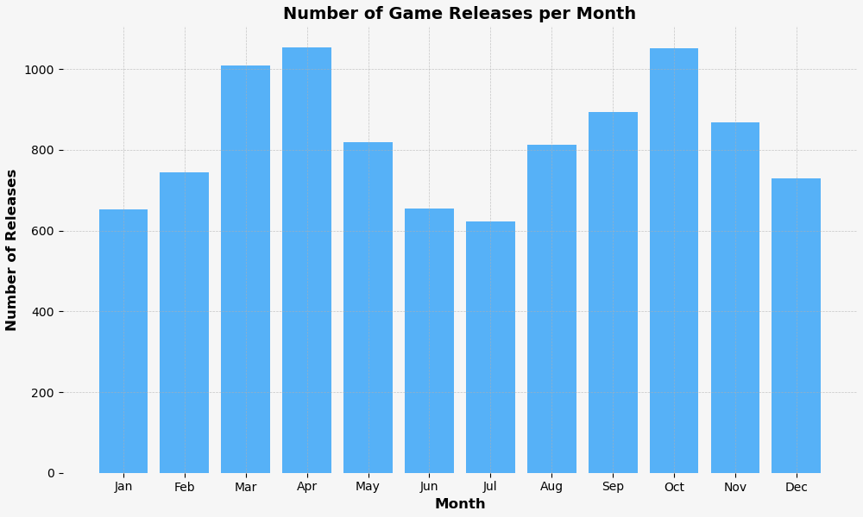
When’s the best time to save your wallet?
Games are most released in April and October
Most likely due to being first financial quarter and holidays.
Summer holidays have small releases as people are on Holiday, and Steam has a big Summer Sale.

Slide 14
Building the Semantic Recommender

Slide 15
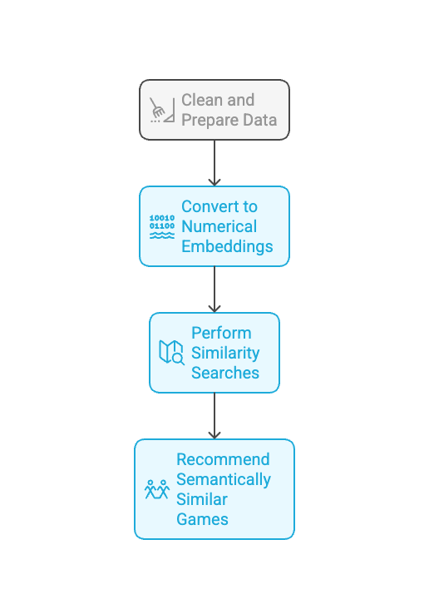

Building the Semantic Recommender
Cleaned and prepared the game description data.
Converted the text into numerical embeddings using OpenAI’s embedding model.
Performed similarity searches to recommend semantically similar games.
generated by napkin ai

Slide 16
Demo Time!

Slide 17
Summary & Next Steps

Slide 18

Summary & Next Steps
Objective: Create a game recommendation system.
Solution: Built a semantic-based recommender using game data and text similarity.
Next Steps: Improve filtering and accuracy by integrating large language models (LLMs).

Slide 19
THANK YOU

Slide 20
